Slide 1

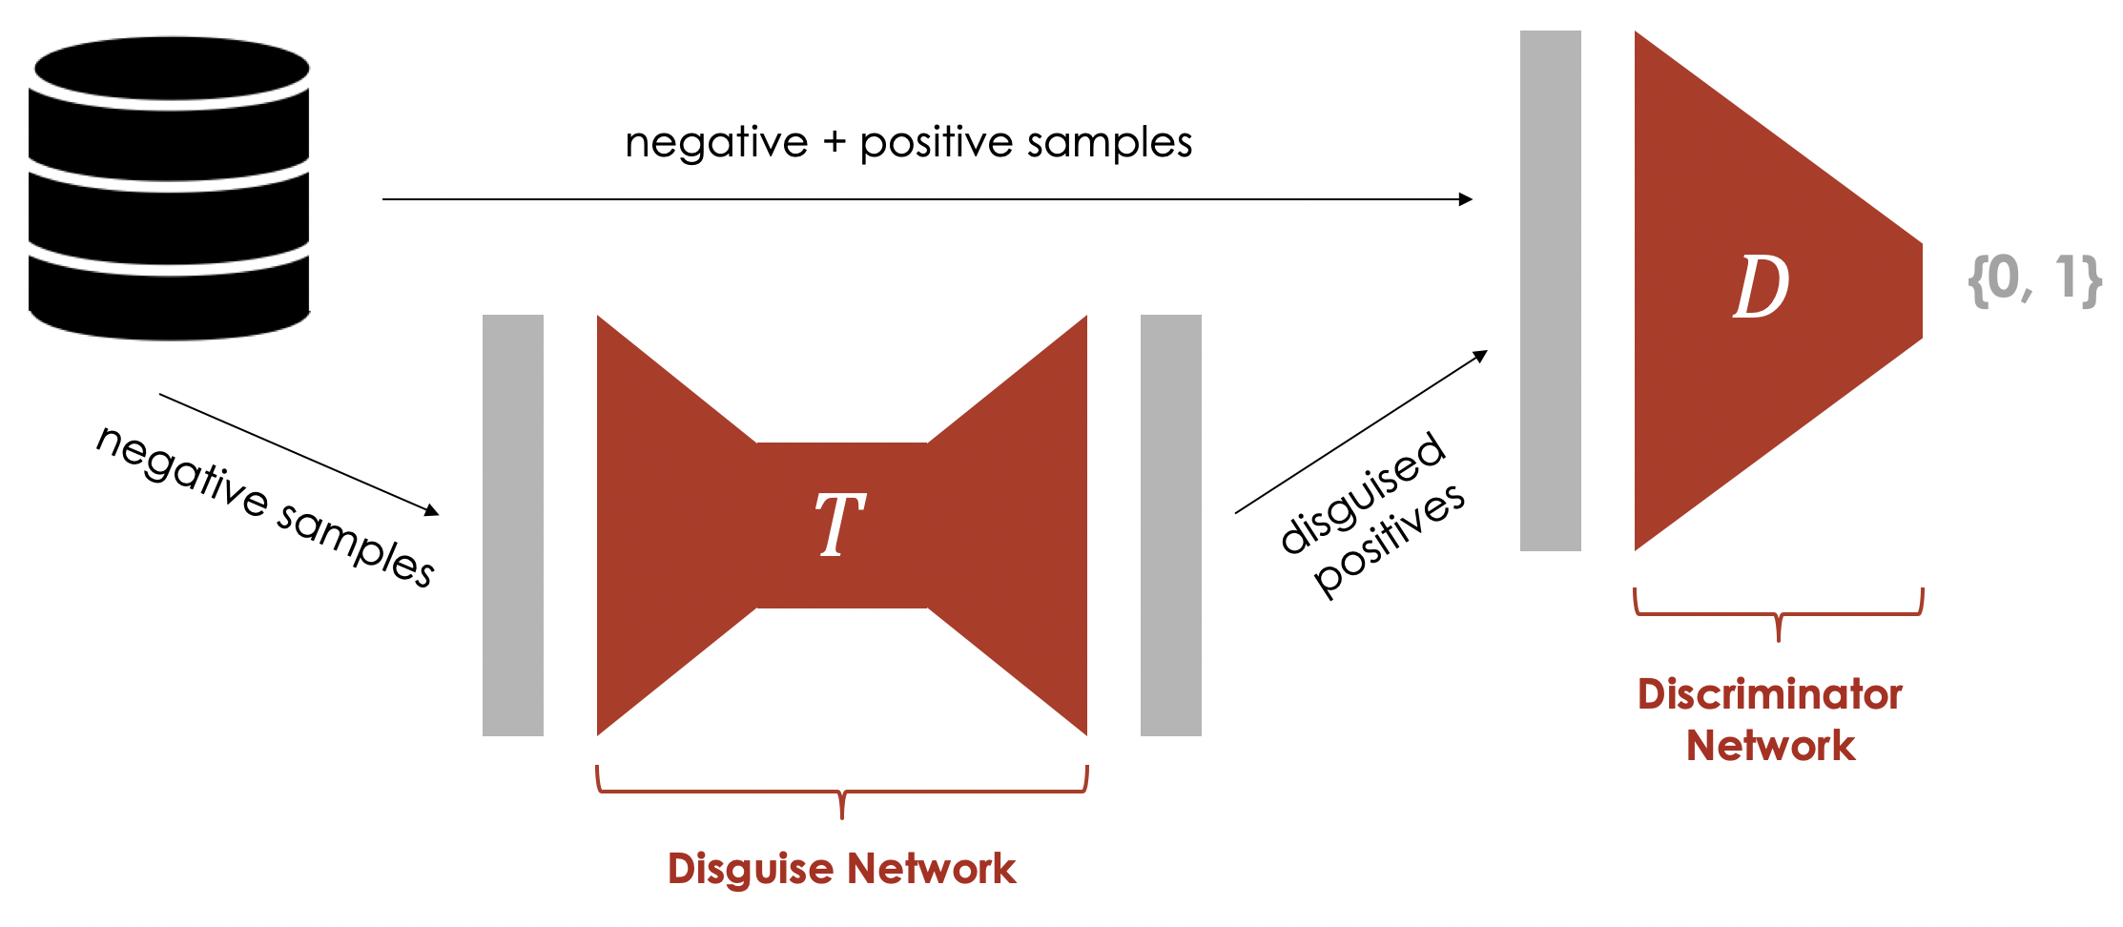
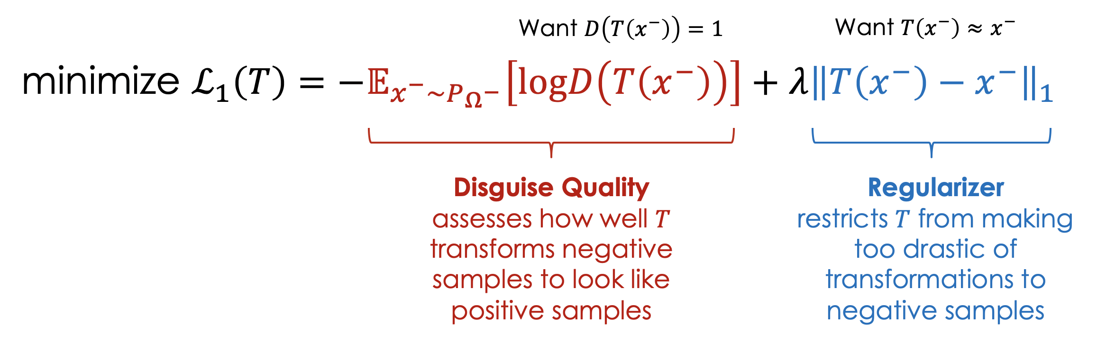
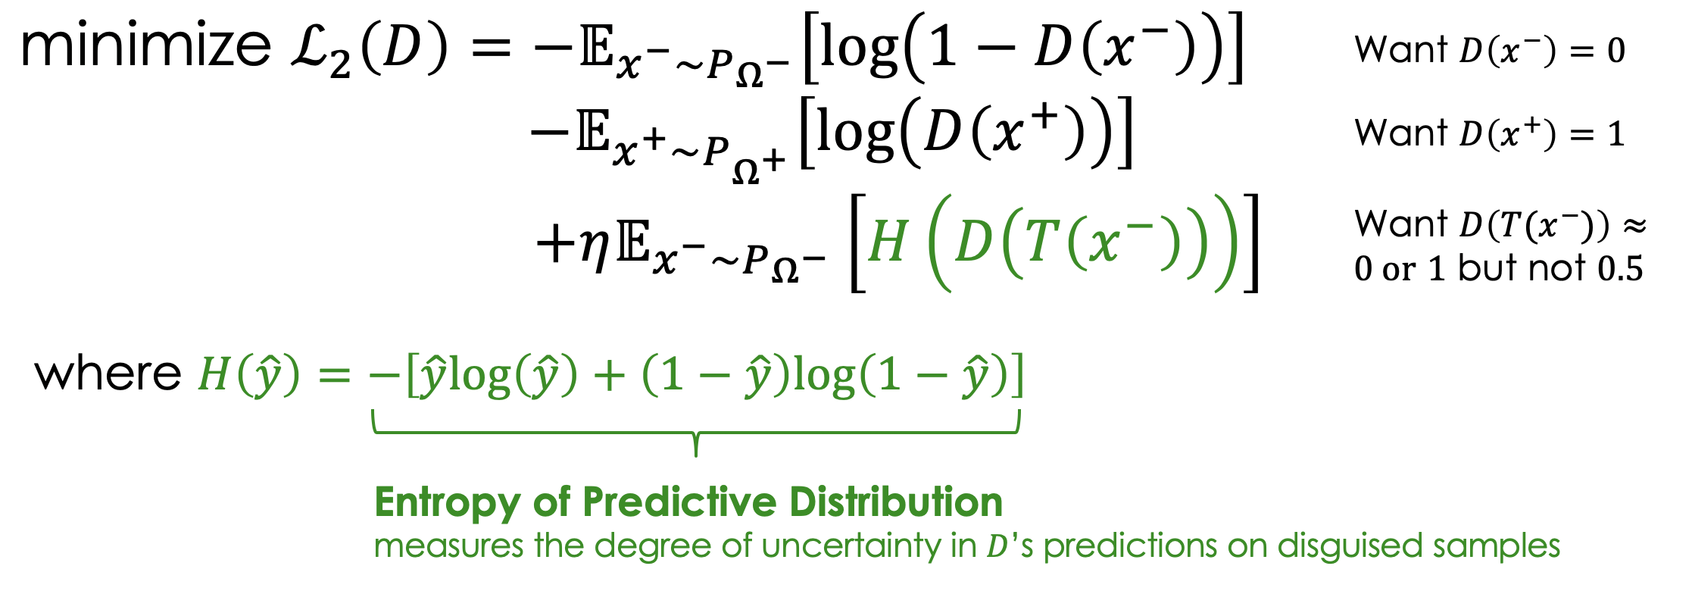
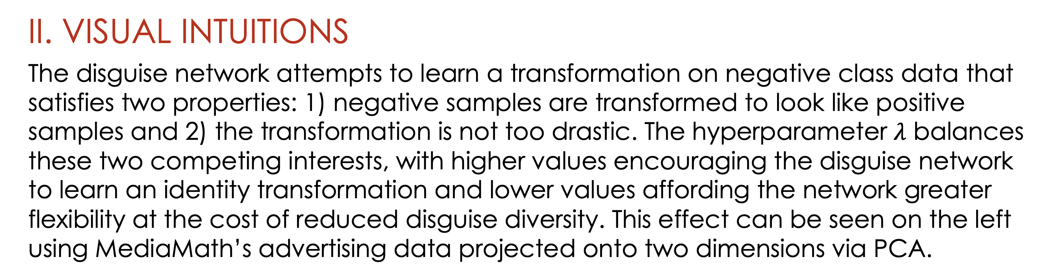
Disguise Adversarial Networks for Imbalanced Click-through Rate Prediction
Derek Zhao, James Xue, Chaitanya Dara
Sai Pavan Kumar Unnam, Daniel Gomez
Industry Mentors: Prasad Chalasani, Aravind Sadagopan
Faculty Mentor: Eleni Drinea
Data Science Capstone Project
with
I. THE PROBLEM OF IMBALANCED DATA
A common issue in using machine learning to predict ad conversions in click-through rate datasets is the imbalanced classification problem: binary classifiers struggle to train effectively due to the lack of sufficient exposure to positive (minority) class samples. We explore the effectiveness of a novel neural architecture, the Disguise Adversarial Network (DAN)^{1,} a synthetic oversampling technique that transforms negative samples into positive samples, thus rebalancing the dataset.
II. VISUAL INTUITIONS
The disguise network attempts to learn a transformation on negative class data that satisfies two properties: 1) negative samples are transformed to look like positive samples and 2) the transformation is not too drastic. The hyperparameter $λ$ balances these two competing interests, with higher values encouraging the disguise network to learn an identity transformation and lower values affording the network greater flexibility at the cost of reduced disguise diversity. This effect can be seen on the left using MediaMath’s advertising data projected onto two dimensions via PCA.
Features
Samples
0
1
The rightmost figure shows a heatmap of scaled transformation magnitudes across 400 random samples of negative data. Certain features are noticeably more relevant for performing successful transformations than others. The disguise network can be a powerful tool for inferring sample-specific feature importance.
III. MIXED RESULTS
The DAN does not appear to offer benefits in tasks where the data is linearly separable or where base models already predict with high recall. To account for this, we further skew MediaMath’s training data from 11% positive to 1% positive while leaving validation and test sets unchanged. Under these conditions, the DAN is able to approximate the performance of models trained on the original dataset.
Positive class proportion (train) | Disg. | Discr. | Accuracy | AUROC | Precision | Recall
0.11 | No | Logistic | 0.9173 | 0.9844 | 0.5795 | 0.9789
0.11 | No | 64 32 | 0.9173 | 0.9843 | 0.5800 | 0.9754
0.11 | 256 x 4 | 64 32 | 0.9168 | 0.9844 | 0.5794 | 0.9653
0.5 | No | Logistic | 0.9155 | 0.9650 | 0.5732 | 0.9901
0.5 | No | 64 32 | 0.9155 | 0.9668 | 0.5728 | 0.9933
0.01 | No | 64 32 | 0.9073 | 0.9809 | 0.6568 | 0.3768
0.01 | 256 x 4 | 64 32 | 0.9181 | 0.9838 | 0.5899 | 0.9041
¹ Deng, Yue & Shen, Yilin & Jin Hongxia, ‘Disguise Adversarial Networks for Click-through Rate Prediction’, in Proceedings of the Twenty-Sixth Joint Conference on Artificial Intelligence, 2017.

